Slide 1
Introduction
Syllabus
Industry Trend Towards Integration in Embedded System Design
Introducing SoPC and Embedded System Design Flow
Introducing EDA Tools and Lab Board

Slide 2
Embedded Systems Design in the Old Days
Systems were built by using many discrete parts
FPGA, memory, and I/O
Logic design tools from a variety of suppliers were (and still are) used to specify their individual functionalities as well as integrating them to function together.
The CPU side of the product was (and still is) most often a discrete part.

Slide 3
Embedded Systems Design in the Old Days
The interfacing of the CPU to the logic, memory, and I/O systems is performed through the logic tools.
The software side was (and still is) implemented by using specialized tools for code and OS development.
The hardware and software interfacing work is performed by using a combination of these tools and, in some cases, co-verification or co-simulation tools.

Slide 4
Changes that are Undergoing
In the later part of the 1990s, many of the logic functions became integrated into single devices, such as Virtex™ families from Xilinx.
Larger amounts of memory are still off-chip, but more memory became available as new families were introduced and densities increased.
This enabled more of the logic design to be developed and implemented as a single unit rather than as discrete parts that required additional interfacing.

Slide 5
What’s Happening Now
With the advent of the platform FPGA and SoC ASICs, merging much of the discrete functionality into a single part is now reality.
Unlocking the full potential of fully hardware-and-software programmable systems: All Programmable SoC, both as an end product and as an advantageous development process, requires a coupling of the silicon, the hardware and software IP, and the development tools into a cohesive unit of parts and design solutions.

Slide 6
Integration in System Design
Embedded Software Tools
CPU
Logic + Memory + IP + Processors + RocketIO
(Virtex-II Pro™)
CPU
Embedded Software Tools
Embedded Software Tools
FPGA + Memory + IP +
High Speed IO
(4K & Virtex™)
Logic Design Tools
Integration of Functions
FPGA
I/O
Programmable Systems
usher in a new era of system design integration possibilities
Logic Design Tools
Memory
Logic Design Tools
Time
Notes:
In the past, systems were built by using many discrete parts, including FPGAs, memory, and I/O. Logic design tools from a variety of suppliers were (and still are) used to specify their individual functionality as well as integrating them to function together.
The CPU side of the product was (and still is) most often a discrete part. The interfacing of the CPU to the logic, memory, and I/O systems is performed through the logic tools. The software side was (and still is) implemented by using specialized tools for code and OS development. The hardware and software interfacing work is performed by using a combination of these tools and, in some cases, co-verification or co-simulation tools.
In the later part of the 1990s, many of the logic functions became integrated into single devices, such as the 4K and Virtex™ families from Xilinx. Larger amounts of memory are still off-chip, but more memory became available as new families were introduced and densities increased. This enabled more of the logic design to be developed and implemented as a single unit rather than as discrete parts that required additional interfacing. However, there were no real changes made in the CPU side of the development.
With the advent of the Platform FPGA and SoC ASICs, merging much of the discrete functionality into a single part is now reality. Unlocking the full potential of fully hardware-and-software programmable systems, both as an end product and as an advantageous development process, requires a coupling of the silicon, the hardware and software IP, and the development tools into a cohesive unit of parts and design solutions.
"Programmable system-on-chip solutions will revolutionize the way designers do microprocessor-based designs," said contributor Anna S. Chiang, director of marketing for Altera's Excalibur business unit. "What is essential to the emergence and adoption of these new [devices] is providing a complete and integrated hardware and software solution that enables hardware design, system-software development, system generation and IP [intellectual-property] block integration, modeling and debug in a cohesive and easy-to-use design environment."

Slide 7
Programmable SoC Solutions
Revolutionize the way designers do microprocessor-based designs.
Provide a complete and integrated hardware and software solution that enables hardware design, system-software development, system generation and IP block integration, modeling and debug in a cohesive and easy-to-use design environment.
Notes:
"Programmable system-on-chip solutions will revolutionize the way designers do microprocessor-based designs," said contributor Anna S. Chiang, director of marketing for Altera's Excalibur business unit. "What is essential to the emergence and adoption of these new [devices] is providing a complete and integrated hardware and software solution that enables hardware design, system-software development, system generation and IP [intellectual-property] block integration, modeling and debug in a cohesive and easy-to-use design environment."

Slide 8
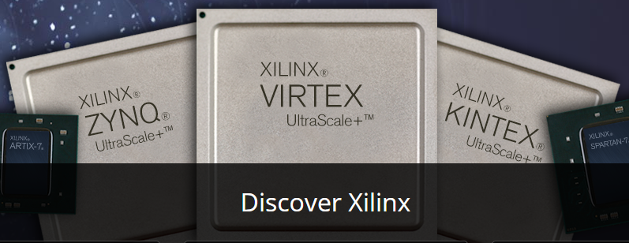
SoC Platform
System on Chip
System On Chip
Application
Specific
Integrated
Circuit
System On Programmable Chip
Field
Programmable
Gate
Array
We are here

Slide 9
Hardware Design Process for SoPC
Choose chip with required hard cores inside
Add required soft cores
Add user logic

Slide 10
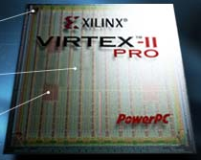
SoPC Design Tool Chain
Standard
Software
Flow
Standard
Hardware
Flow
C/C++ code
VHDL / Verilog
Simulator
Compiler / Linker
Synthesizer
Object code
Place & Route
.elf
.bit
Data2BRAM
PPC code in on-chip memory
PPC code in off-chip memory
Download to FPGA
Debugger
Download to FPGA
Chip Scope Pro Tools

Slide 11
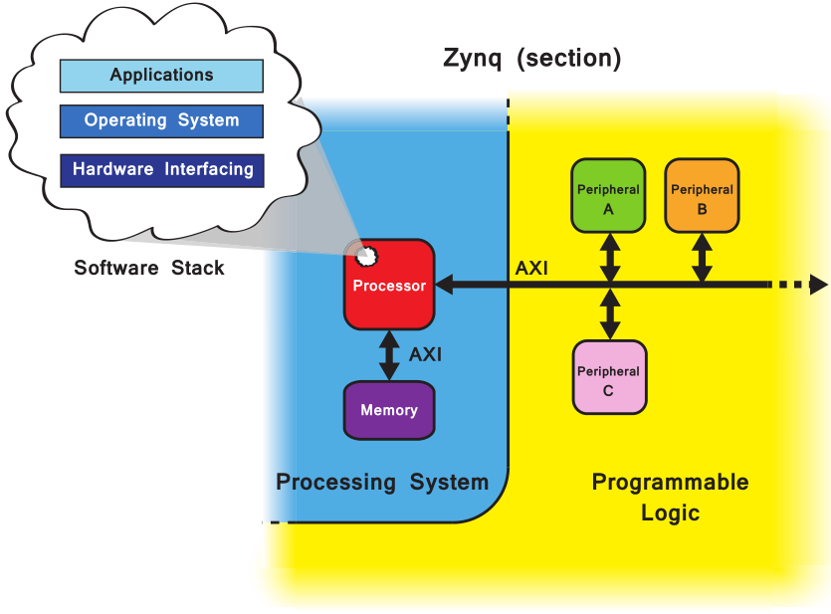
Vivado – Xilinx New Generation of All Programmable Soc Design

Slide 12
Vivado Components
Vivado/IP Integrator
Design environment for configuration of PS, and hardware design for PL
Hardware Platform (xml)
Platform, software, and peripheral simulation
Vivado logic analyzer integration
Software Development Kit (SDK)
Project workspace
Hardware platform definition
Board Support Package (BSP)
Software application
Software debugging
Hardware Design
HW/SW Simulation
Software Design
HW/SW Debug

Slide 13
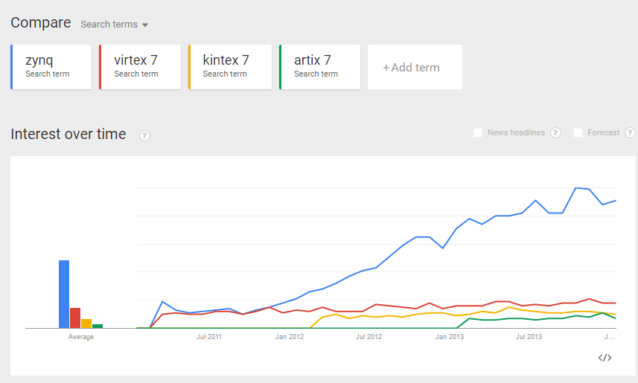
Zynq and the trend towards ARM-FPGA architectures
Notes:
Zynq and the trend towards ARM-FPGA architectures
Since the release of the Series 7 devices from Xilinx in 2011, one member of the family is clearly dominating the others in terms of popularity: the Zynq-7000 SoC. Did Xilinx put all their marketing efforts into the Zynq or is this proof of a new trend in FPGA technology?
To answer that question let me talk about why I think the Zynq SoC has been so popular.
1. The Zynq bridges a gap in the market for high-performance, calculation-intensive devices. In this market, there are generally three types of implementations: microprocessor based solutions (software solutions), FPGA based solutions (hardware solutions) and a combination of both. Most people accept that (at least in theory) the highest performance and energy efficient implementation of most calculation-intensive algorithms is achieved on FPGA technology. The problem is that FPGA designers are hard to find and creating one internally takes a lot of time. Another problem is that the open-source community for IP cores is not very developed, at least in comparison to open-source software. The Zynq SoC bridges that gap by providing a powerful microprocessor based solution, while offering the possibility to accelerate the implementation through hardware offloading to an on-chip FPGA. With the Zynq, a customer can port their existing application to run on the ARM processor, without the need for an FPGA designer. Once the application has been proven on the Zynq, they can then gradually develop the FPGA part of the chip and explore the possibilities for hardware acceleration.
2. The Zynq supports Linux. A lot of calculation-intensive applications run on Linux and many more will continue to be developed for Linux simply because it allows the developer to leverage a ton of existing drivers and libraries, and it frees the software designer from having to know too much about the underlying hardware. Of course, a pure FPGA can also run Linux, you simply have to implement a soft-microprocessor such as the Microblaze in the FPGA fabric – but the performance isn’t great, the Microblaze is a single core processor that you would typically clock at 100MHz. The Zynq in comparison carries an ARM Dual-core Cortex-A9 processor that clocks at 800MHz. When performance is critical, the processor has to be powerful enough to run the OS fast and transparently, and the Zynq delivers.
3. The Zynq has a large community of users. Many companies and people in the open source community have recognized the potential of the Zynq and chosen it as the base for several open-source hardware projects such as the Red Pitaya, theParallella and the ZedBoard. The huge success of these projects and visibility on Kickstarter.com has created a large community of Zynq users. There’s also the huge Linux community that Xilinx is winning over by maintaining a Linux distribution for the Zynq on Github as well as thorough documentation on their wiki page. The open-source community is overrepresented by early adopters and people who are willing to jump on new technologies and spread the word – and in my opinion, Xilinx is doing a great job at winning them over. More users means more support which is exactly what customers want to see when they’re considering adopting new technologies.
In general terms, I believe the Zynq has been successful because it provides FPGA solutions and benefits to customers

Slide 14
A New Trend in FPGA Technology: Zynq-7000 SoC
1. The Zynq bridges a gap in the market for high-performance, calculation-intensive devices, including three types of implementations:
Microprocessor based solutions (software solutions),
FPGA based solutions (hardware solutions) and
A combination of both.
2. The Zynq supports Linux.
3. The Zynq has a large community of users.
Notes:
Zynq and the trend towards ARM-FPGA architectures
Since the release of the Series 7 devices from Xilinx in 2011, one member of the family is clearly dominating the others in terms of popularity: the Zynq-7000 SoC. Did Xilinx put all their marketing efforts into the Zynq or is this proof of a new trend in FPGA technology?
To answer that question let me talk about why I think the Zynq SoC has been so popular.
1. The Zynq bridges a gap in the market for high-performance, calculation-intensive devices. In this market, there are generally three types of implementations: microprocessor based solutions (software solutions), FPGA based solutions (hardware solutions) and a combination of both. Most people accept that (at least in theory) the highest performance and energy efficient implementation of most calculation-intensive algorithms is achieved on FPGA technology. The problem is that FPGA designers are hard to find and creating one internally takes a lot of time. Another problem is that the open-source community for IP cores is not very developed, at least in comparison to open-source software. The Zynq SoC bridges that gap by providing a powerful microprocessor based solution, while offering the possibility to accelerate the implementation through hardware offloading to an on-chip FPGA. With the Zynq, a customer can port their existing application to run on the ARM processor, without the need for an FPGA designer. Once the application has been proven on the Zynq, they can then gradually develop the FPGA part of the chip and explore the possibilities for hardware acceleration.
2. The Zynq supports Linux. A lot of calculation-intensive applications run on Linux and many more will continue to be developed for Linux simply because it allows the developer to leverage a ton of existing drivers and libraries, and it frees the software designer from having to know too much about the underlying hardware. Of course, a pure FPGA can also run Linux, you simply have to implement a soft-microprocessor such as the Microblaze in the FPGA fabric – but the performance isn’t great, the Microblaze is a single core processor that you would typically clock at 100MHz. The Zynq in comparison carries an ARM Dual-core Cortex-A9 processor that clocks at 800MHz. When performance is critical, the processor has to be powerful enough to run the OS fast and transparently, and the Zynq delivers.
3. The Zynq has a large community of users. Many companies and people in the open source community have recognized the potential of the Zynq and chosen it as the base for several open-source hardware projects such as the Red Pitaya, the Parallella and the ZedBoard. The huge success of these projects and visibility on Kickstarter.com has created a large community of Zynq users. There’s also the huge Linux community that Xilinx is winning over by maintaining a Linux distribution for the Zynq on Github as well as thorough documentation on their wiki page. The open-source community is overrepresented by early adopters and people who are willing to jump on new technologies and spread the word – and in my opinion, Xilinx is doing a great job at winning them over. More users means more support which is exactly what customers want to see when they’re considering adopting new technologies.
In general terms, I believe the Zynq has been successful because it provides FPGA solutions and benefits to customers

Slide 15
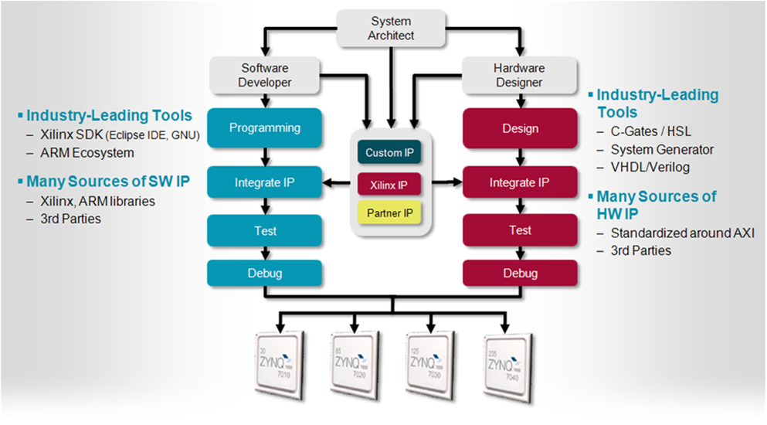
Embedded System Design Flow for Zynq-7000 AP SoC

Slide 16
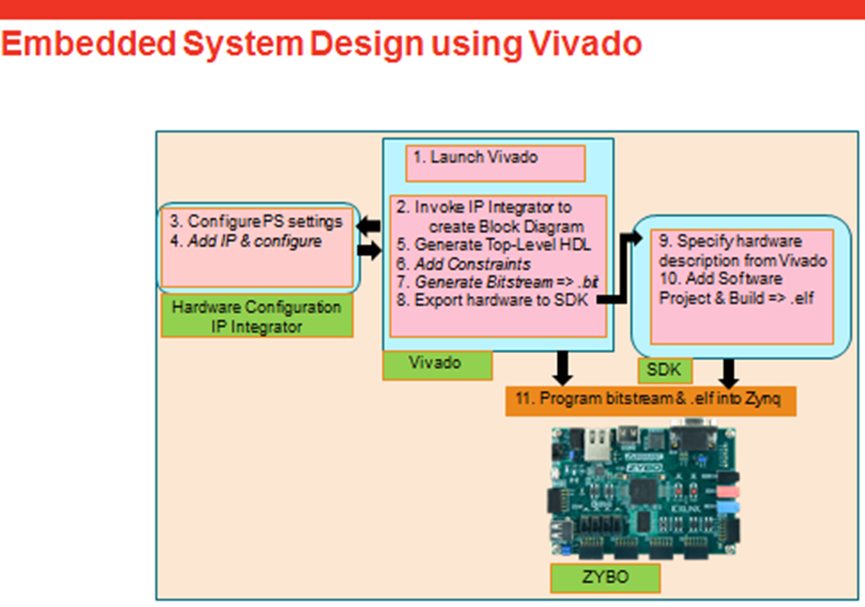

Slide 17
Course Objectives
After completing this course, you will be able to:
Rapidly architect an embedded system targeting Zynq, and the AXI4 interface standard, using Vivado and IP Integrator
Extend the system by adding peripherals
Add Xilinx provided peripherals from the IP catalog
Create and add a custom peripheral using IP Integrator
Create and debug software applications
Create software applications in the Software Development Kit (SDK)
Debug an application on-chip using the GNU debugger via SDK

Slide 18
Topics to be Covered
Embedded system design flow using Vivado 2018.3 System Edition
Introducing FPGA and Zybo
Introducing ARM Cortex-A9 processor architecture
Basic embedded system designs, including GPIO, timers, interrupts, adding IPs and custom IPs, DMA, profiling and hardware accelerators, etc.
Xilinx device driver architecture, adding custom IP into your embedded systems, writing device drivers for custom Ips.

Slide 19
Basic Labs
Lab 1: Simple Hardware Design
Zynq Architecture
Extending the Embedded System into PL
Lab 2: Adding IPs in Programmable Logic
Adding Your Own Peripheral
Lab 3: Creating and Adding Custom IP
Software Development Environment
Lab 4: Writing Basic Software Applications
Software Development and Debugging
Lab 5: Software Debugging Using SDK
Lab 6: FPGA-Based Embedded System with Timer and Interrupt

Slide 20
ARM Cortex-A9 based Embedded System Design Lab 1 through Lab 6
DDR3
Memory
Controller
ARM
Cortex-A9
PL
Memory
Timer
RS232
UART
AXI
Interconnect
Block
AXI4
AXI-BRAM Controller
BRAM
Interrupt
AXI4-Lite
LED_IP
LED
M_AXI_GP0
AXI4-Lite
GPIO
Push-Buttons
PS
AXI4-Lite
GPIO
DIP Switches
Lab1
Lab2
Lab3
Lab5
Lab6
Lab4 uses hardware built in Lab3

Slide 21
Prerequisites
Basic C programming
Basic understanding of processor-based system
Basic HDL knowledge

Slide 22
Platform Support
Vivado System Edition 2018.3
Xilinx University board
Zybo
Supported Operating Systems
Windows 7 SP1 Professional (64 Bit)
Windows 8.1 Professional (64 Bit)
Red Hat Enterprise Linux 6.5 – 6.6 (64 Bit)
Red Hat Enterprise Linux 7.0 (64 Bit)
SUSE Linux Enterprise 12.0 (64 Bit)
Centos Linux 7.0 (64 Bit)
Ubuntu Linux 14.04 LTS (64 Bit)

Slide 23
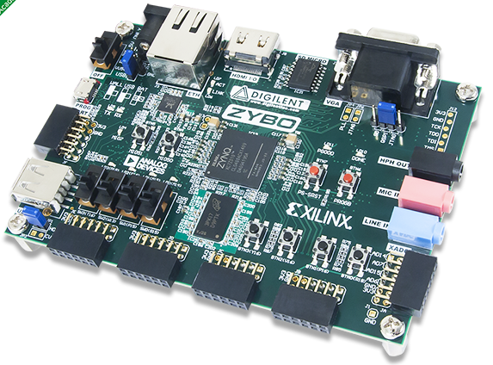
Lab Board - Zybo Zynq-7000 ARM/FPGA SoC Trainer Board
Xilinx Zynq-7000: 28,000 logic cells
240 KB Block RAM
On-chip dual channel, 12-bit, 1 MSPS analog-to-digital converter (XADC)
650 MHz dual-core Cortex™-A9 processor
On-board JTAG programming and UART to USB converter
High-bandwidth peripheral controllers: 1G Ethernet, USB 2.0, SDIO
Low-bandwidth peripheral controller: SPI, UART, I2C
Dual-role (Source/Sink) HDMI port 16-bits per pixel VGA output port
Trimode (1Gbit/100Mbit/10Mbit) Ethernet PHY
OTG USB 2.0 PHY (supports host and device)
External EEPROM (programmed with 48-bit globally unique EUI-48/64™ compatible identifier)
Audio codec with headphone out, microphone and line in jacks
GPIO: 6 pushbuttons, 4 slide switches, 5 LEDs

